Slide 1
Optimization of Polymer Predictors for Drug Delivery Systems, using Machine Learning approaches.
Shloka Negi and Dr. Prateek K. Jha
Department of Chemical Engineering, Indian Institute of Technology, Roorkee, Uttarakhand
&
Department of Pharmaceutical Engg. & Tech., Indian Institute of Technology, BHU, Varanasi

Slide 2
MOTIVATION
A set of polymers (FDA approved) –
{P1, P2, P3,…., Pn)
Poorly water soluble drug molecules (D)
Drug-Polymer combinations –
{DP1, DP2, DP3,……., DPn}
How to choose the best polymer for the drug out of the different combinations?
Do experiments on all combinations.
Very tedious
Time consuming
Use Machine Learning tools for making predictions.
Easy
Saves time

Slide 3
PLAN OF ACTION
Use of ML for finding the most suitable polymer for the drug – ‘Nifedipine’
Required Data Is Available
Required Data Is Not Available + Some Other Data Required To Predict The Relevant Data Is Also Not Available
Tg (Glass Transition Temperature)
Sol (Solubility Parameter)
Required Data Is Not Available, But Some Data Is Available.
Perform few experiments to find the values of the easily obtainable data.
Use these relevant parameters in the context to Drug Delivery, and make predictions about the most suitable polymer for Nifedipine.
Predict the missing relevant parameters, using the other available parameters.
Predict the required data

Slide 4
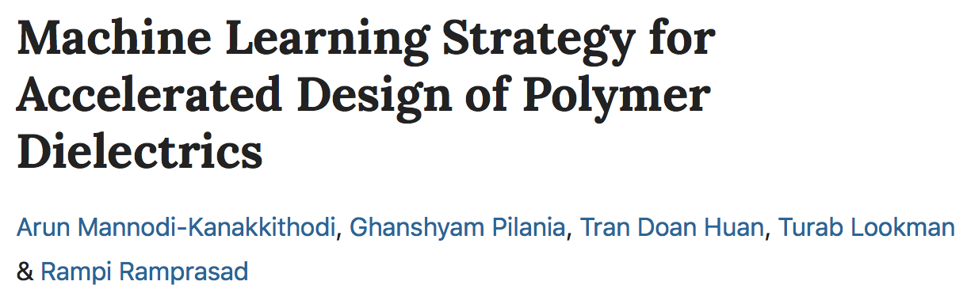
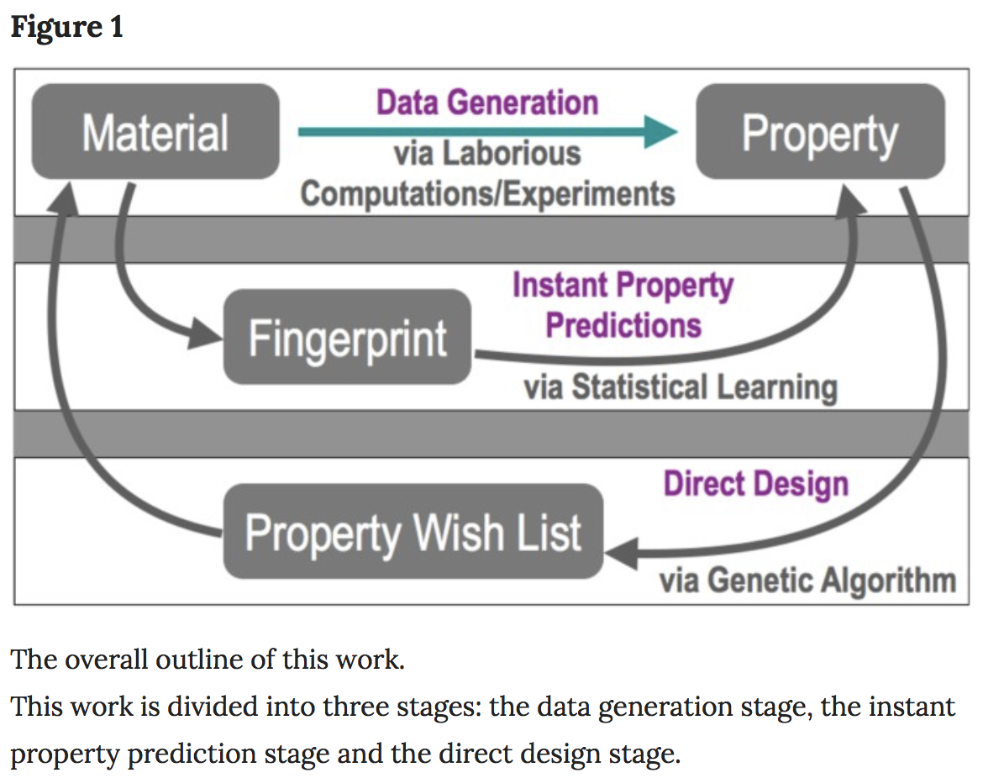
PAST RESEARCH WORK
Abstract
The ability to efficiently design new and advanced dielectric polymers is hampered by the lack of sufficient, reliable data on wide polymer chemical spaces and the difficulty of generating such data given time and computational/experimental constraints. Here, we address the issue of accelerating polymer dielectrics design by extracting learning models from data generated by accurate state-of-the-art first principles computations for polymers occupying an important part of the chemical subspace. The polymers are ‘fingerprinted’ as simple, easily attainable numerical representations, which are mapped to the properties of interest using a machine learning algorithm to develop an on-demand property prediction model. Further, a genetic algorithm is utilised to optimise polymer constituent blocks in an evolutionary manner, thus directly leading to the design of polymers with given target properties. While this philosophy of learning to make instant predictions and design is demonstrated here for the example of polymer dielectrics, it is equally applicable to other classes of materials as well.

Slide 5
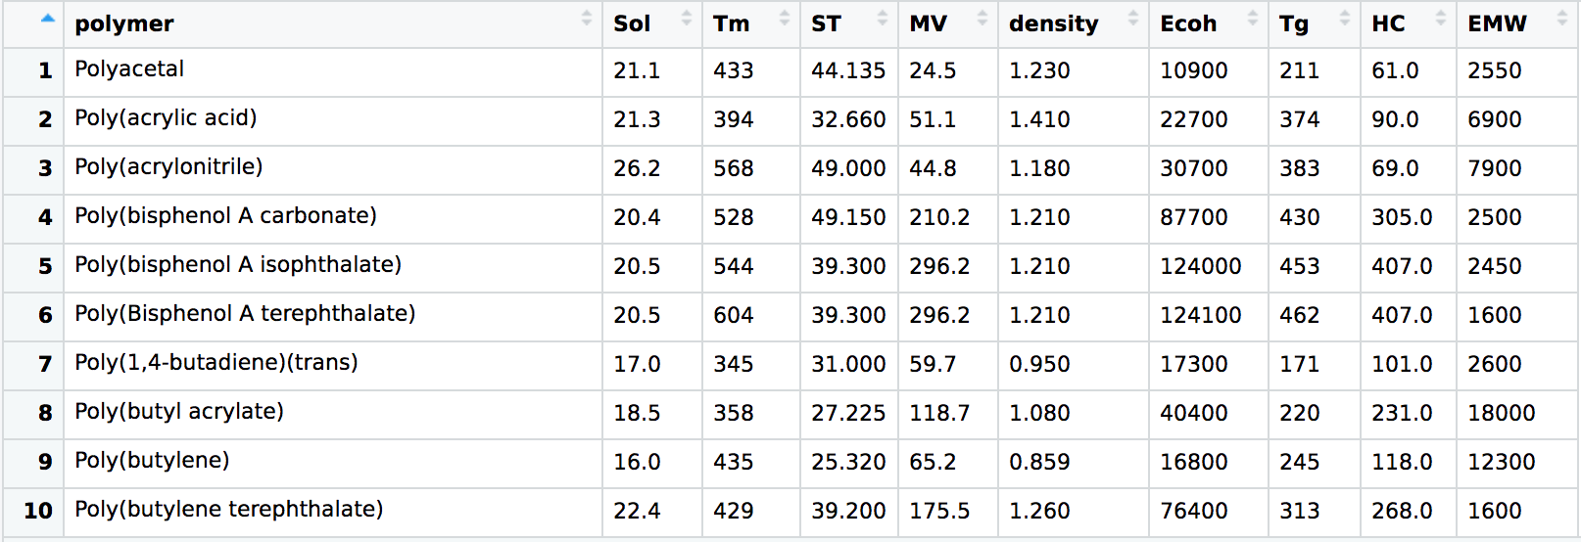
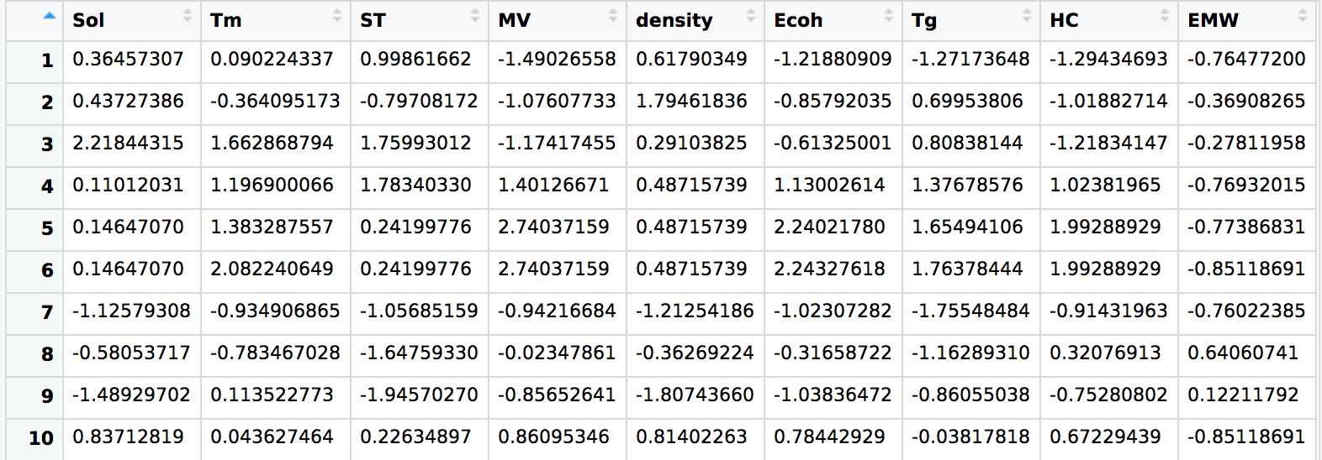
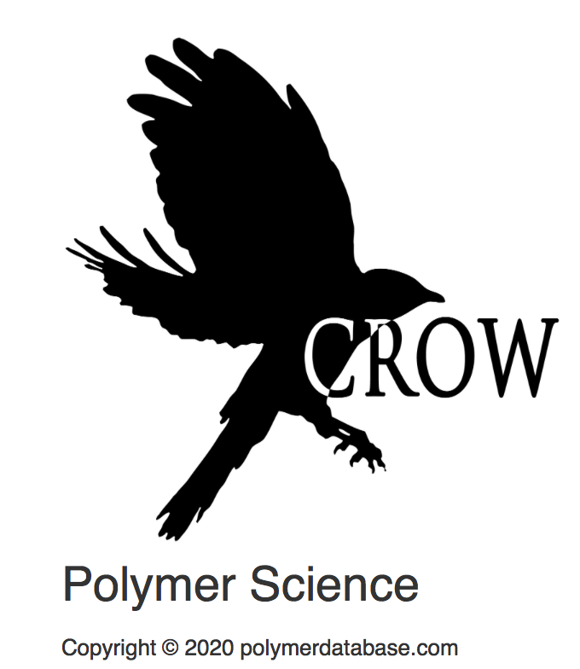
DATA COLLECTION
Raw Data
Normalized data
DATABASES
PolyInfo - Polymer Database for Polymeric Materials Design.
Also called The NIMS Materials Database (MatNavi)
URL – https://mits.nims.go.jp/en/
CROW Polymer Property Database.
URL – polymerdatabase.com

Slide 6
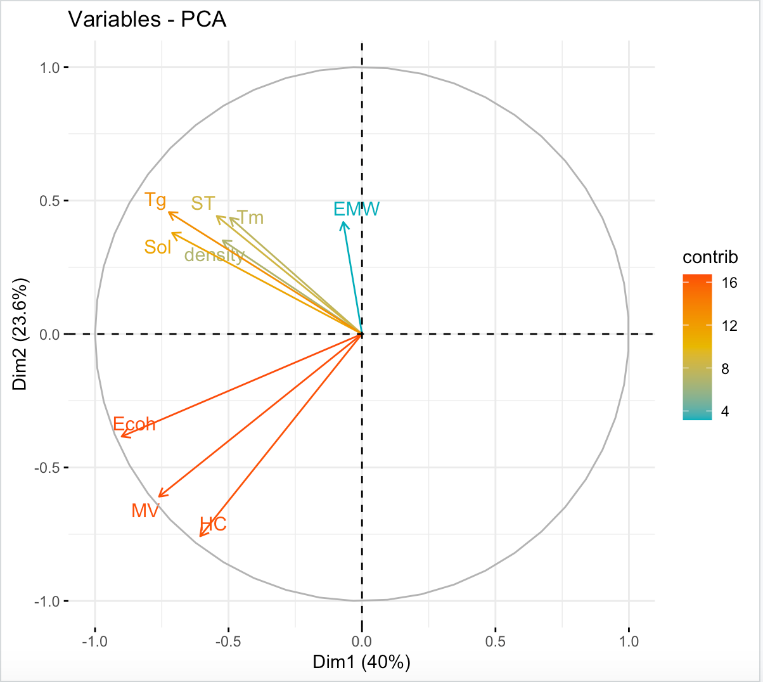
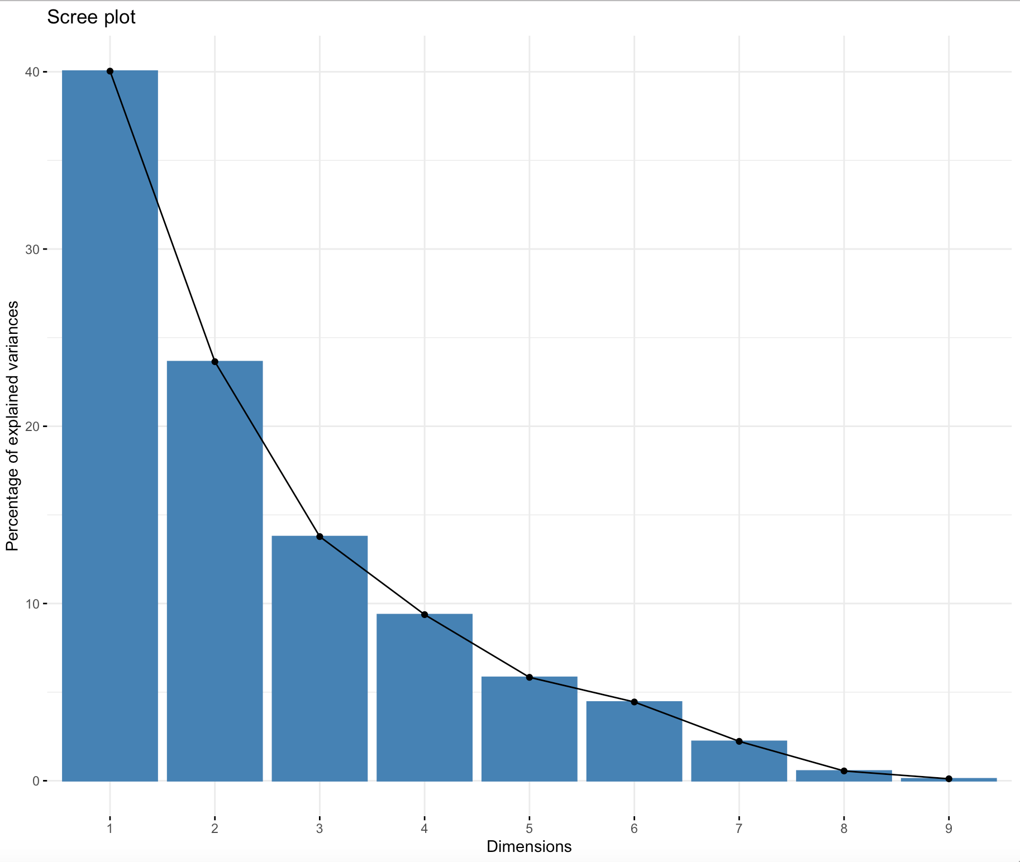
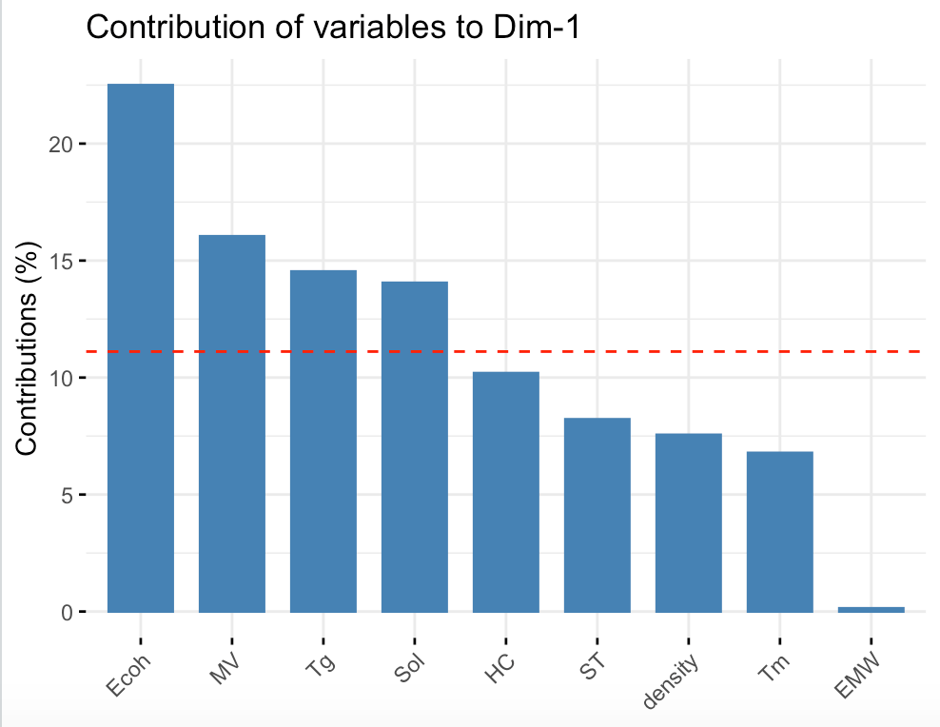
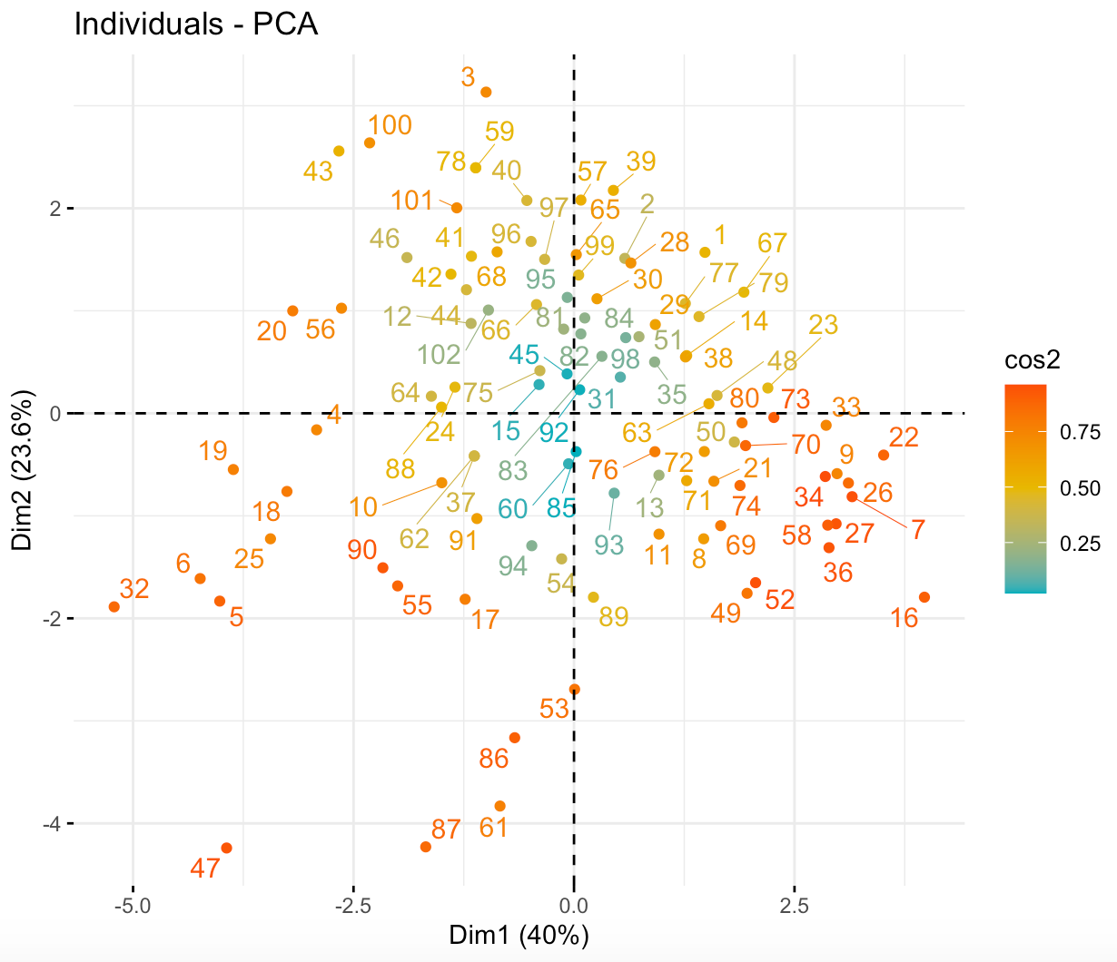
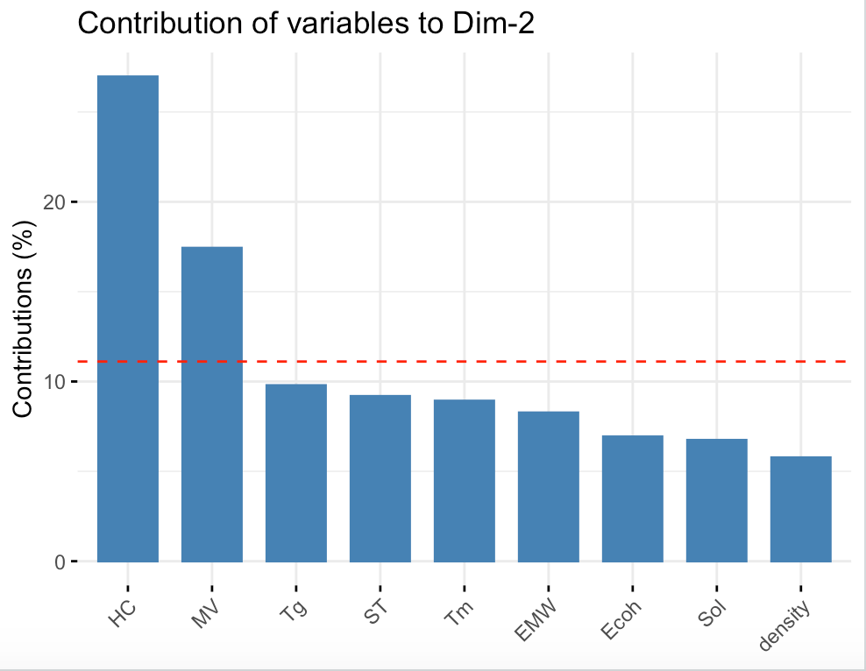
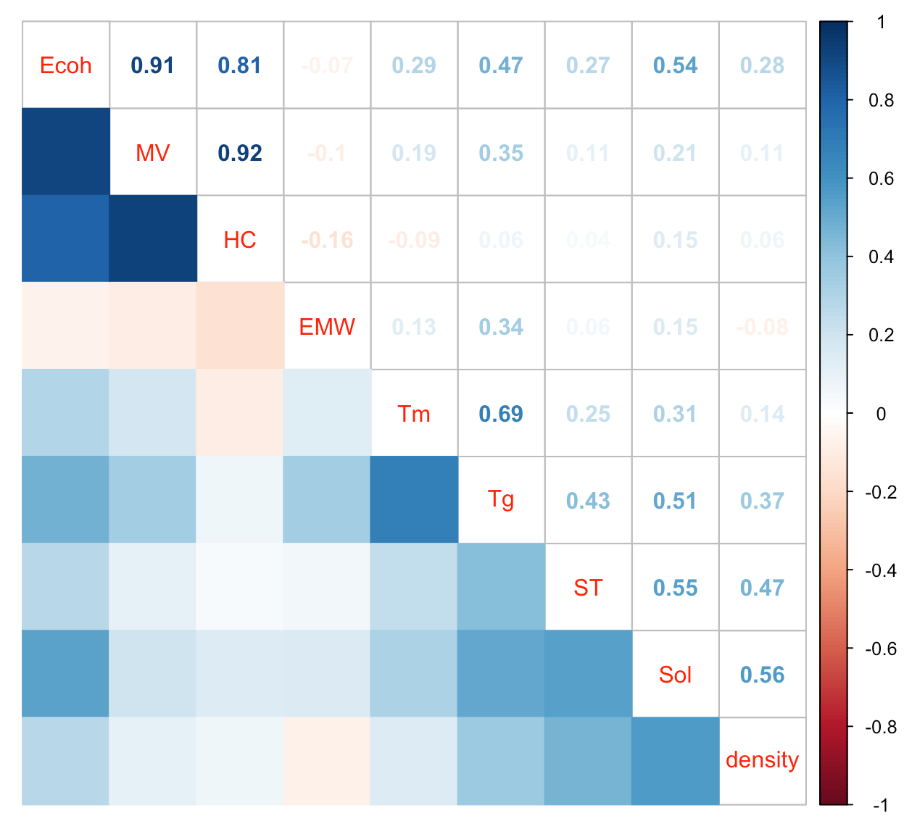
Graph Of Variables
- Loading Plot
Variance Explained by first 4 PCAs = 86.83%
Ecoh, MV, Tg and Sol
Graph Of Individuals
- Score Plot
HC and MV

Slide 7
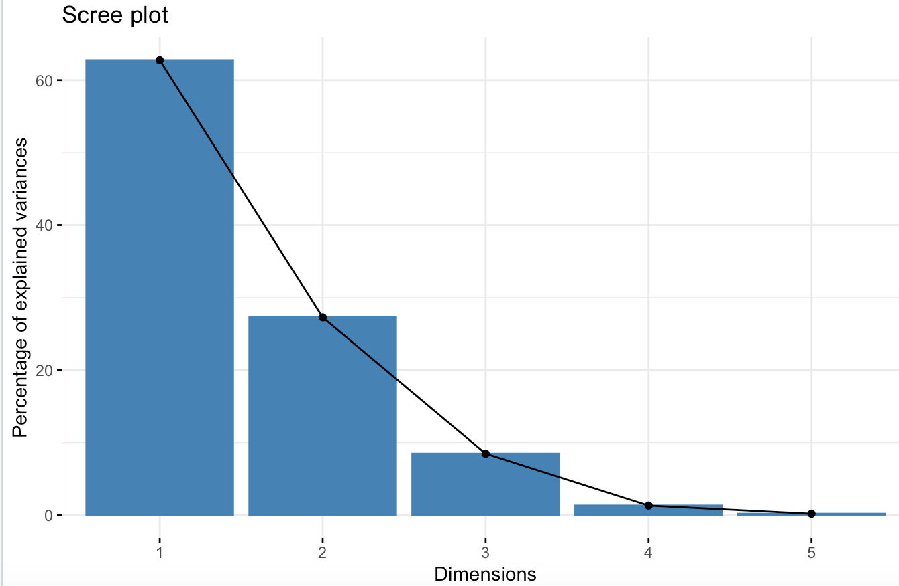
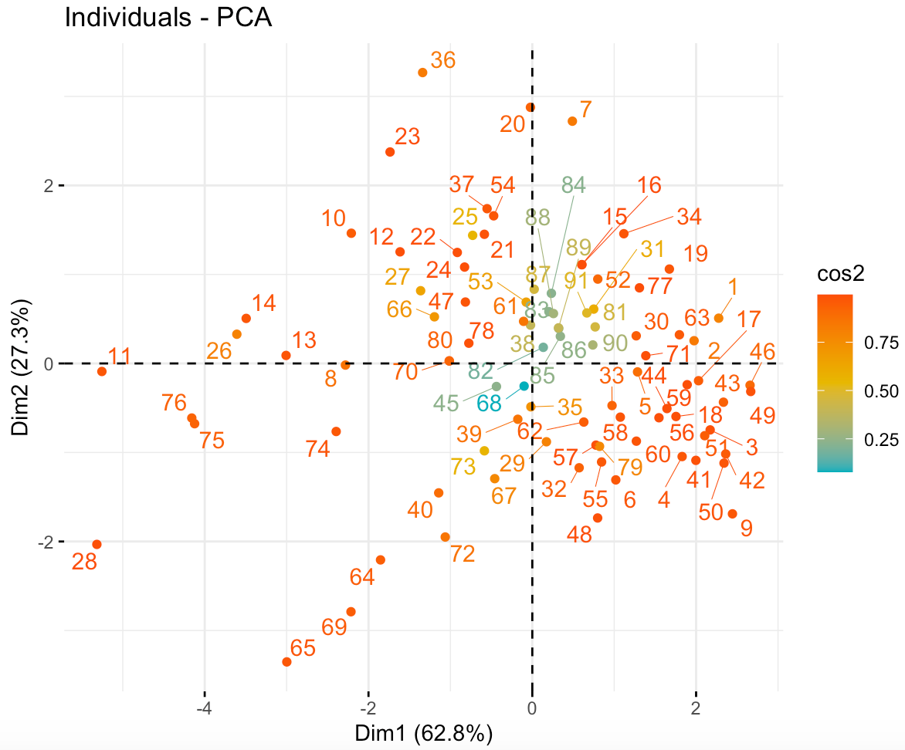
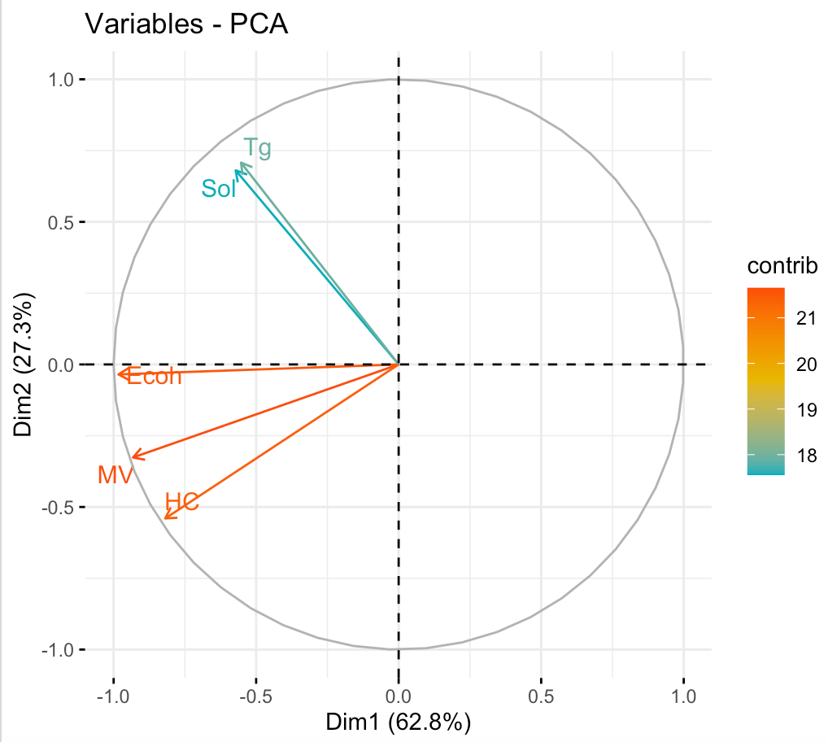
Variance Explained by first 2 PCAs = 90.03%
REMOVING OUTLIERS AND CHOOSING 5 TOP PREDICTORS
These are Ecoh, MV, HC, Sol and Tg.
Importance of components: PC1 PC2 PC3 PC4 PC5 Standard deviation 1.7714 1.1678 0.65088 0.25635 0.09433 Proportion of Variance 0.6276 0.2728 0.08473 0.01314 0.00178 Cumulative Proportion 0.6276 0.9003 0.98508 0.99822 1.00000

Slide 8
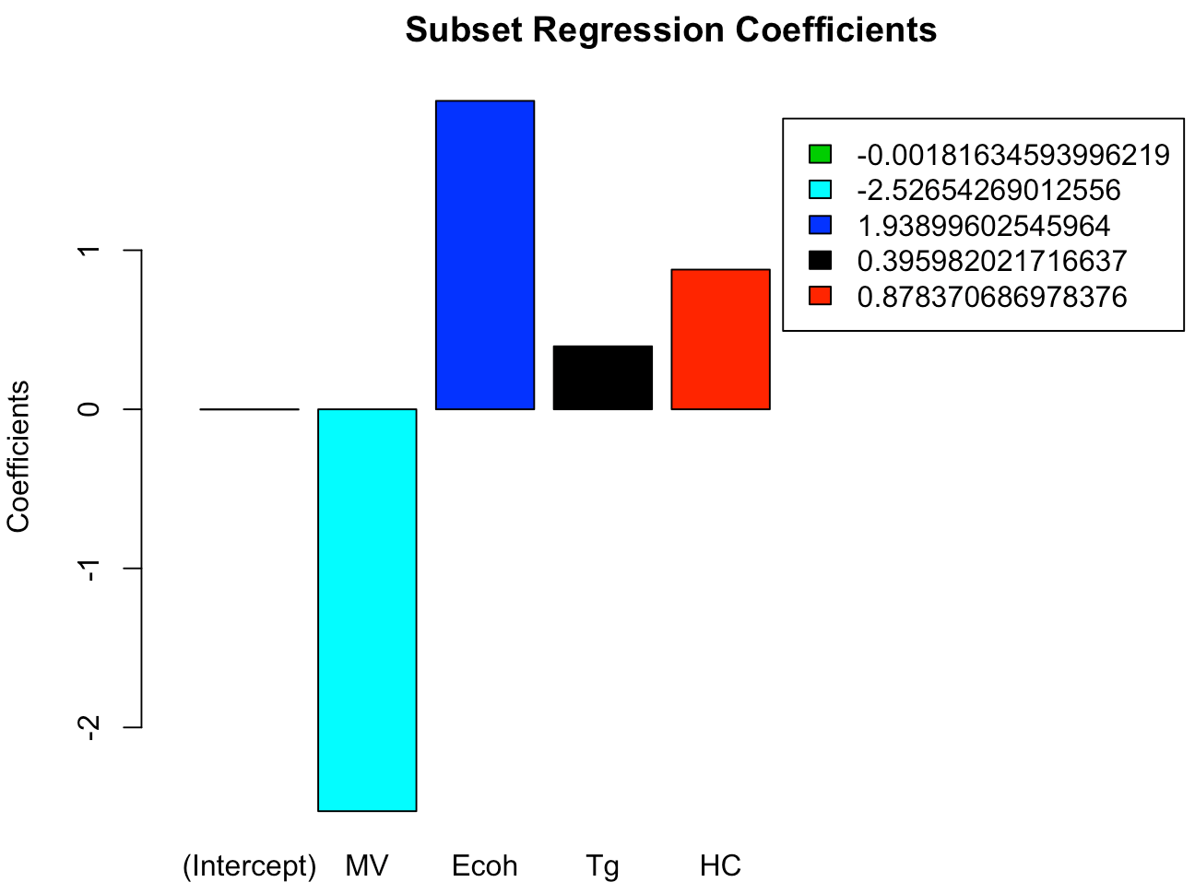
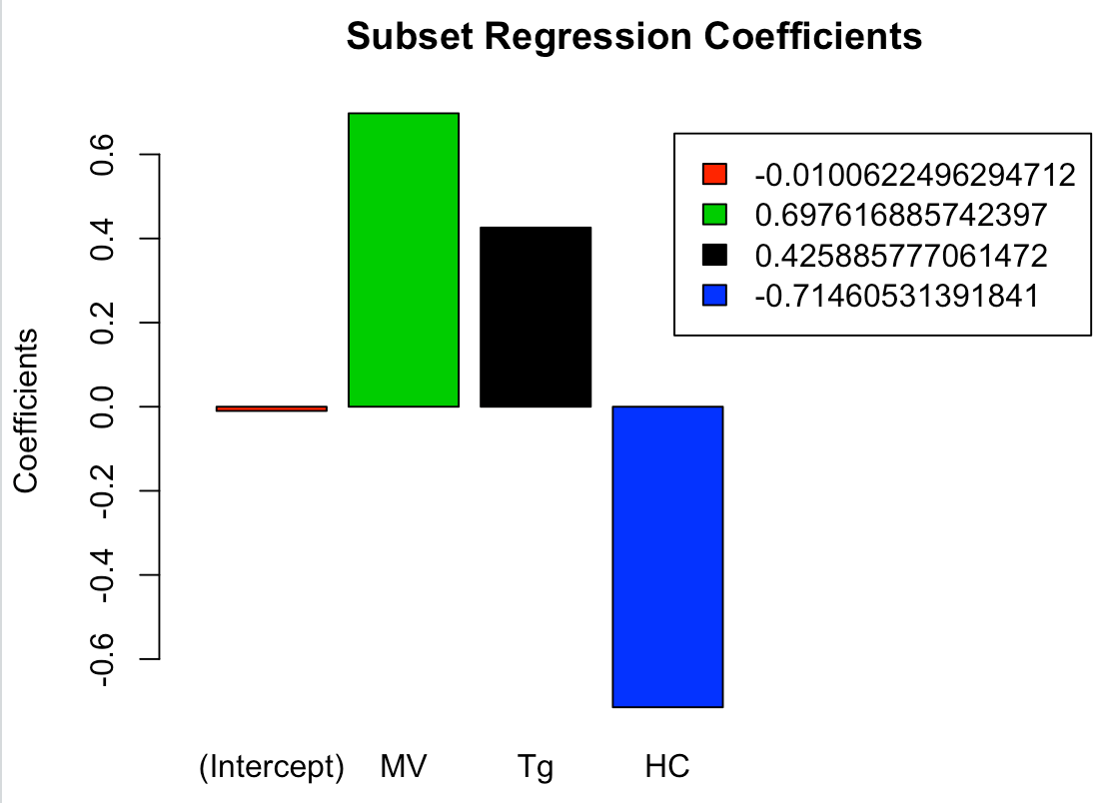
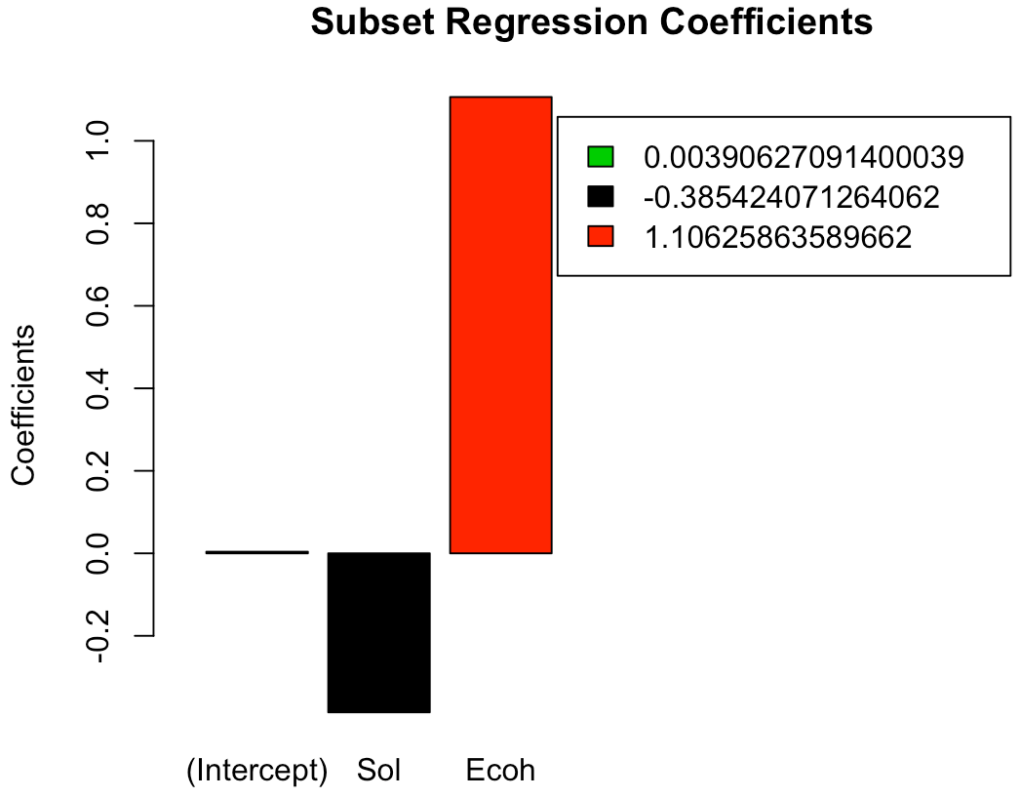
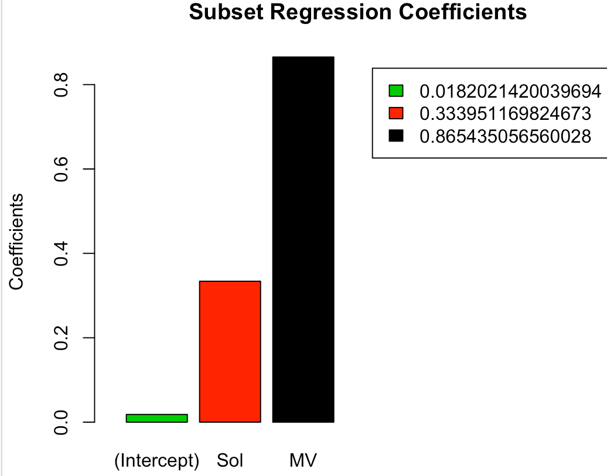
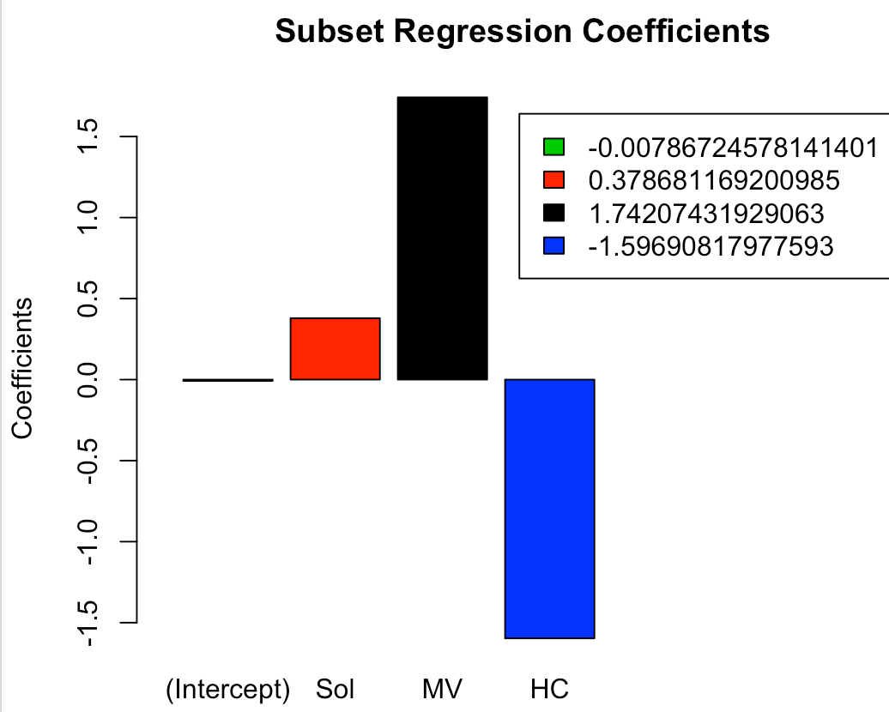
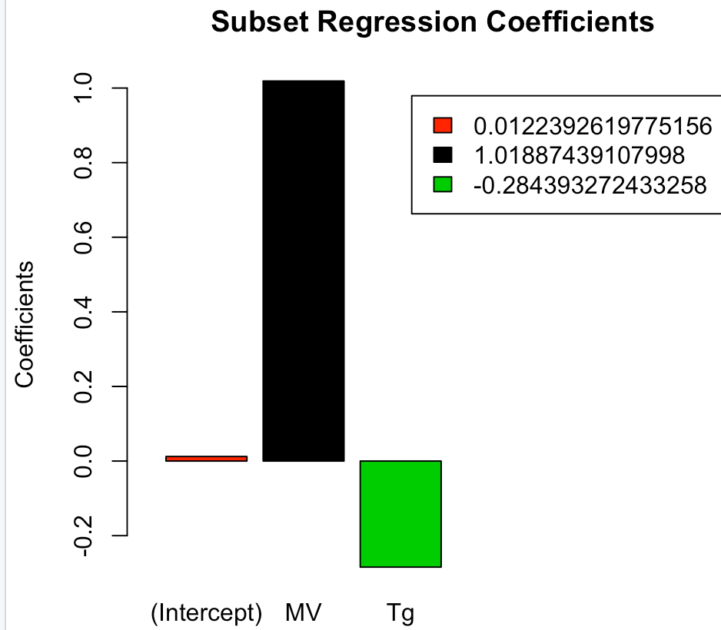
Sol
Tm
MV
4 Predictor
Model
3 Predictor Model
2 Predictor Model
Ecoh
Tg
HC
2 Predictor
Model
3 Predictor
Model
2 Predictor
Model

Slide 9
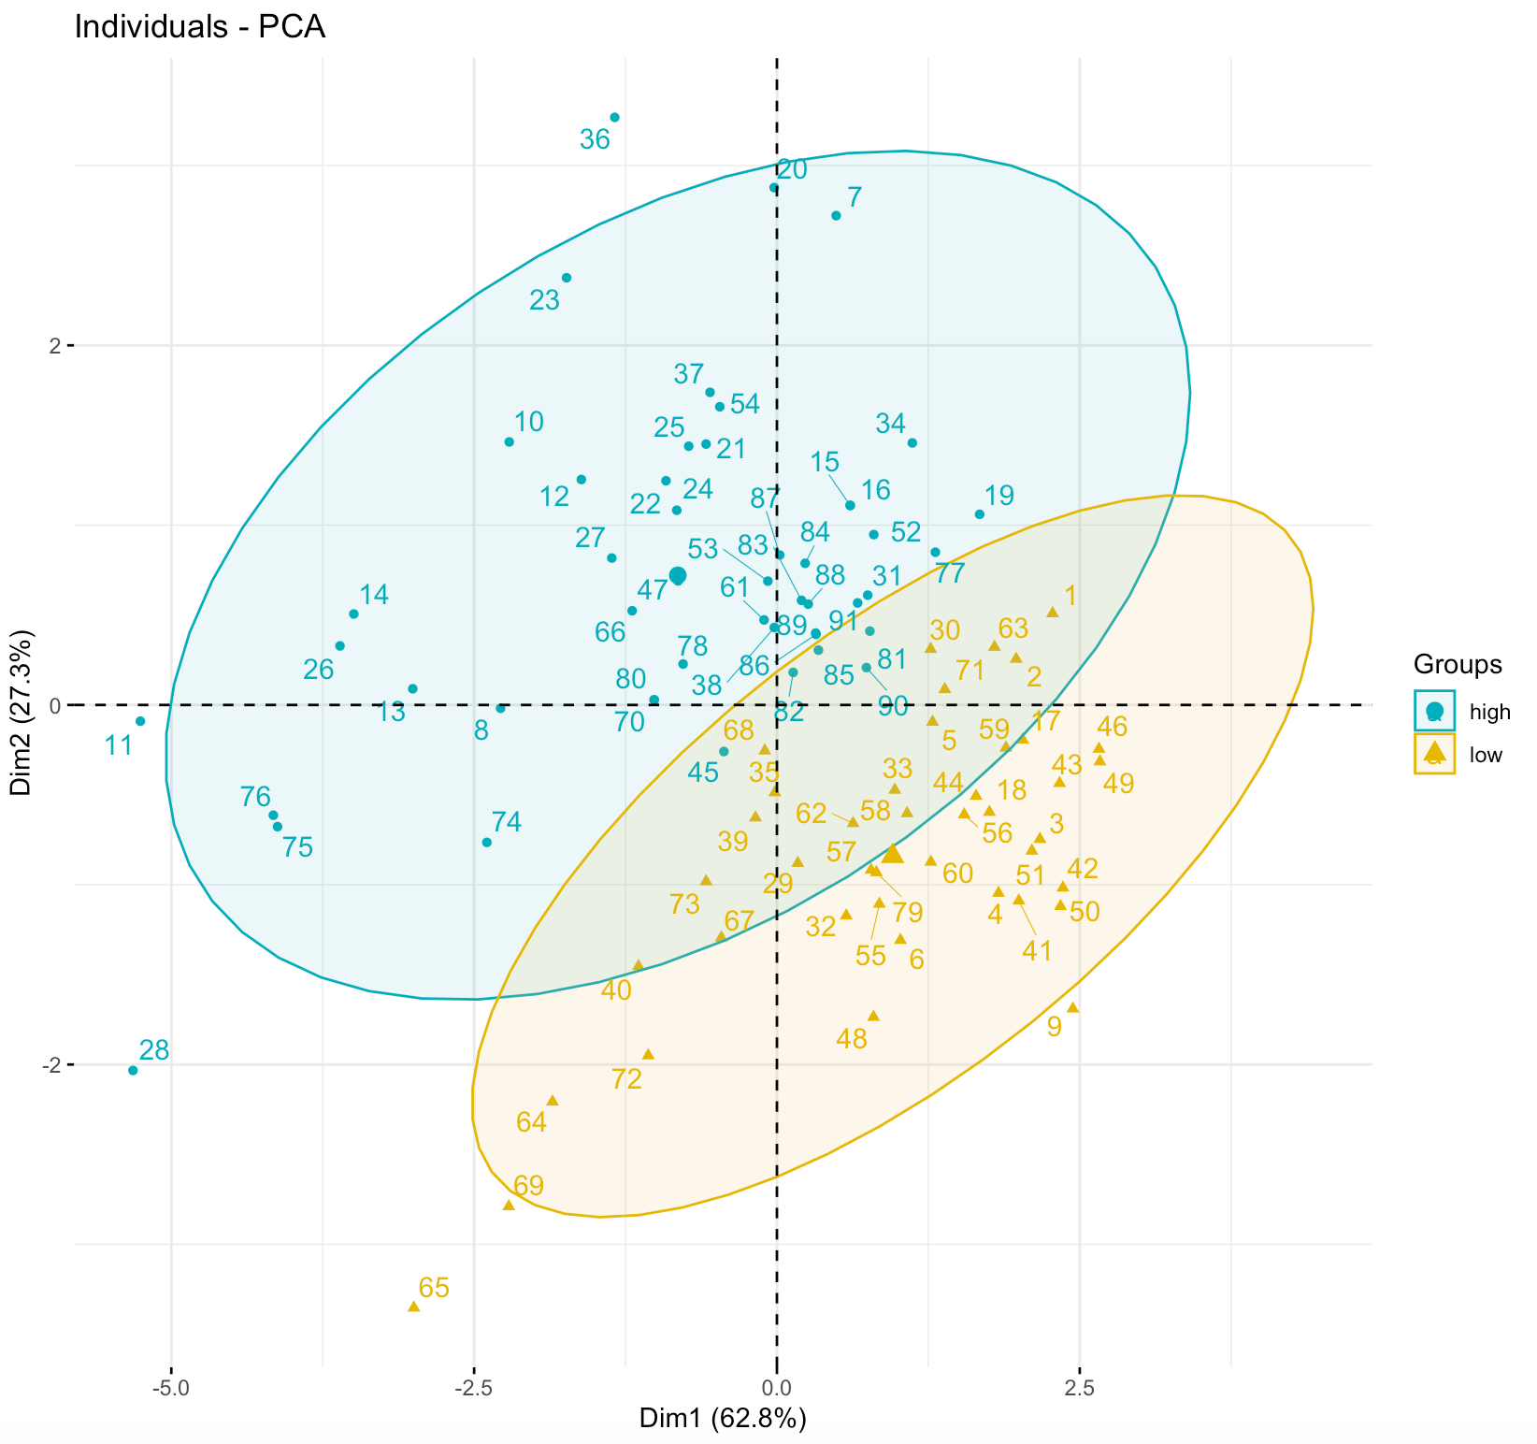
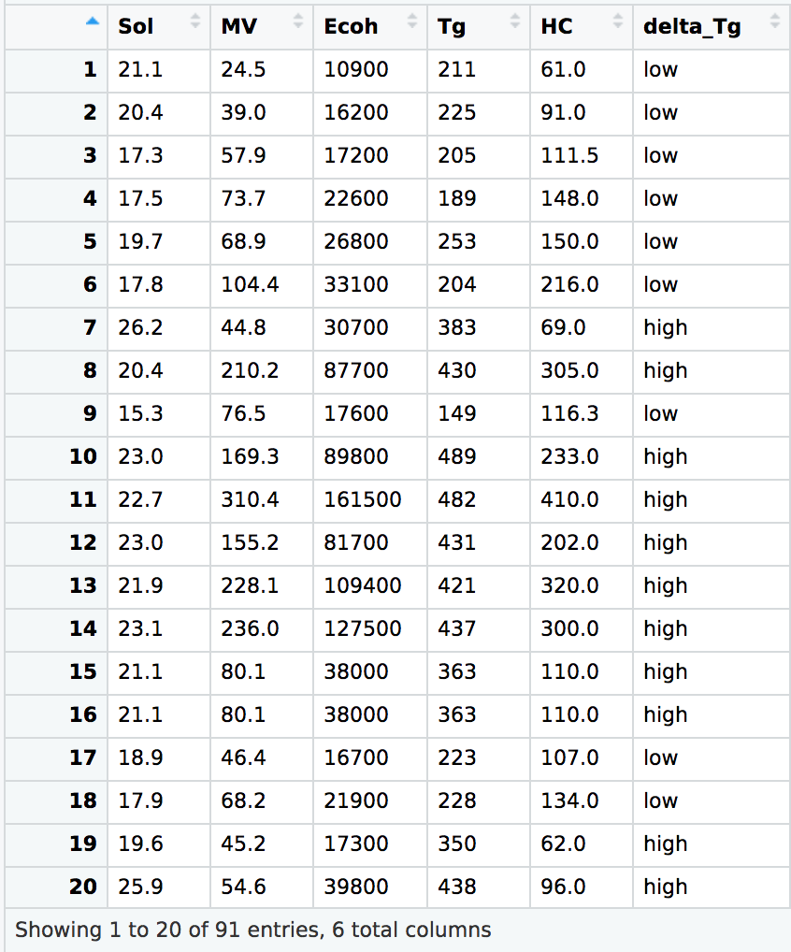
91 observations and 6 variables
These are Ecoh, MV, HC, Sol, Tg and delta_Tg
Tg for Drug Nifedipine – 320 K

Slide 10
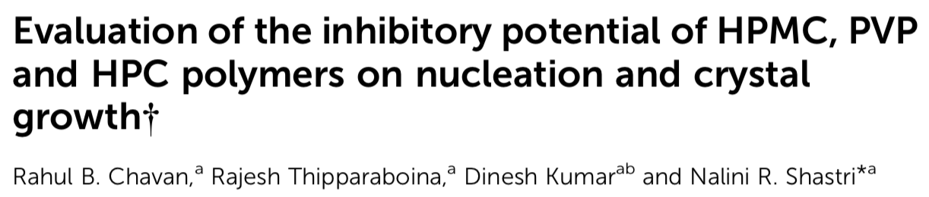
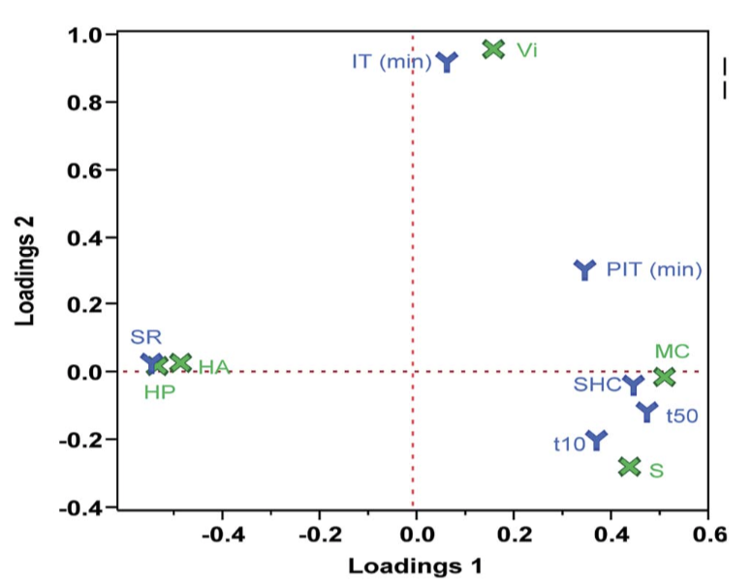
RECOMMENDATIONS – FUTURE WORK
2) Inclusion of drug-polymer interaction parameters
Challenge
1) Inversion of Prediction Pipeline
Response Parameters like –
Induction Time
Precipitation Initiation Time
Supersaturation Holding Capacity
Flory- Huggin’s Interaction Parameter
Enthalpy of Mixing
3) Addressing the issue of choosing the best polymer grade (out of different molecular weights of polymers) for the drug.

